Slide 1
Huawei Intelligent Computing Product & Solutions
Date: March 2021

Slide 2
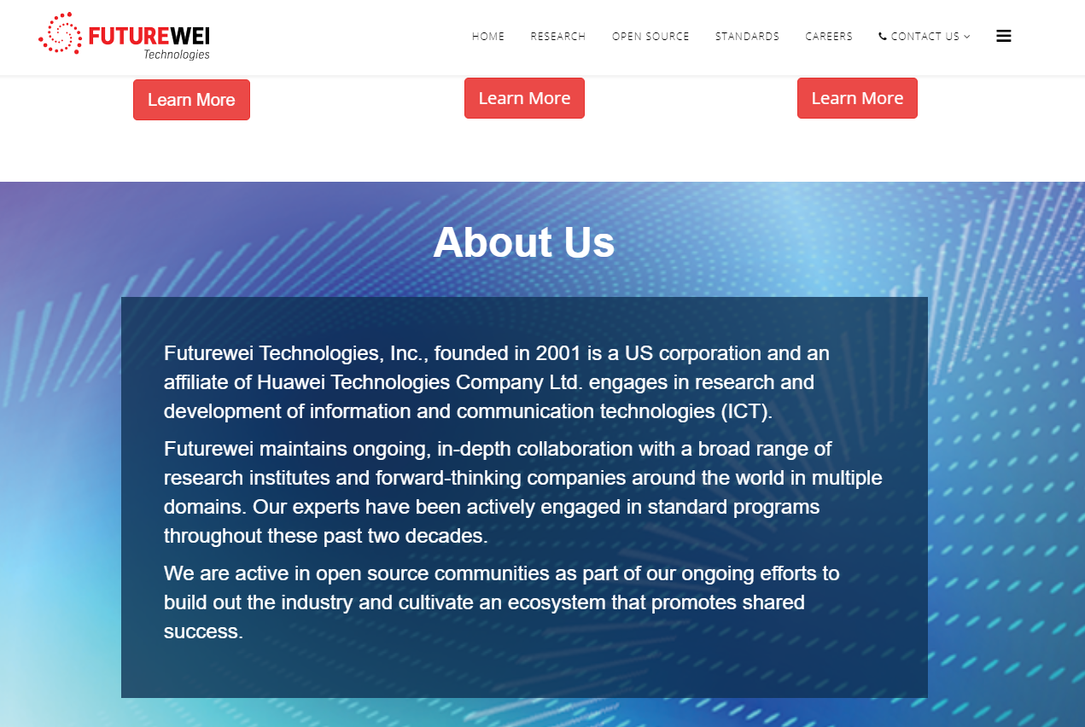
www.futurewei.com

Slide 3
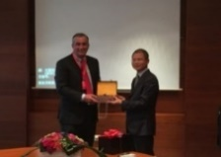
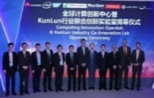
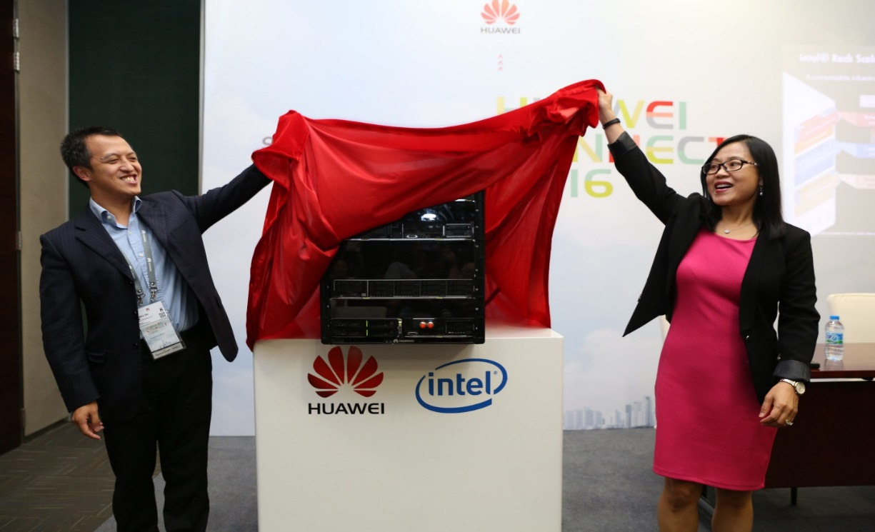
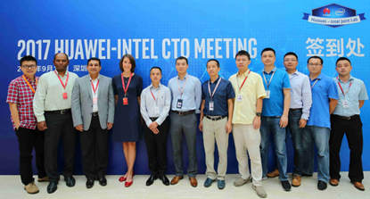
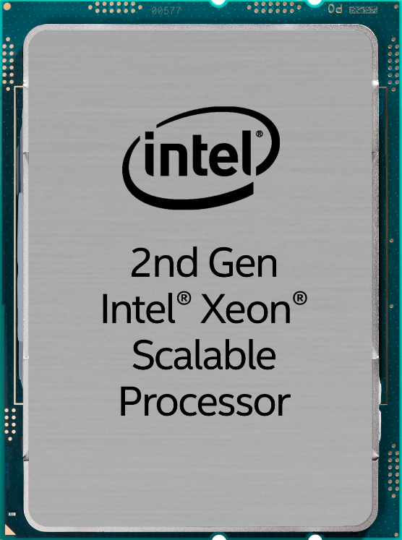

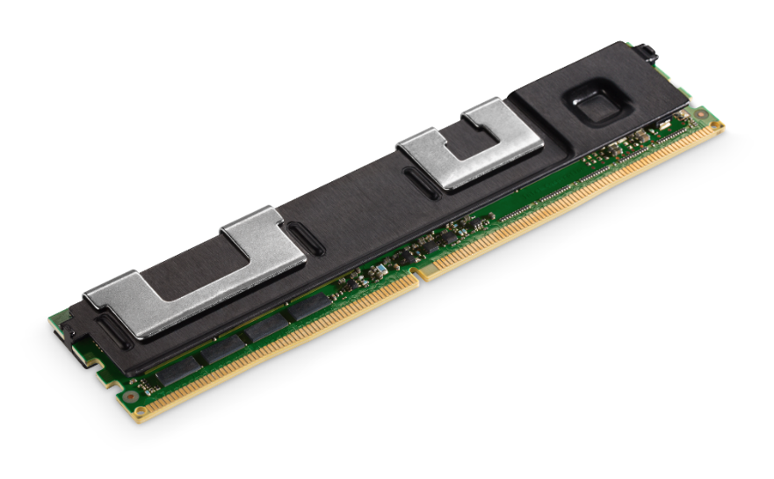
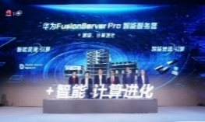

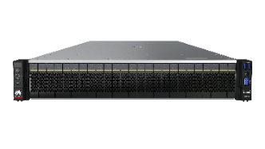
20 Years of Strategic Partnership with Intel
Continuously Providing the Latest Technology and Products
Total 5M+ Units Shipped (2012-2020)
2001
Huawei FusionServer Pro Intelligent Server
In 2001, signed a strategic partnership.
……
V5
V6
V7
2016
2017
2020
2022
Joint launch of KunLun, 32-socket mission-critical server.
Set up a joint innovation computing center in Hangzhou.
1st Gen Skylake
2nd Gen Cascade Lake
3rd Gen Cooper Lake (4-8)
3rd Gen Ice Lake (1-2)
NG Sapphire Rapids
2017
Jointly hold CTO summits to start strategic cooperation in AI, edge computing, and cloud computing.
2019
Cascade Lake Refresh Processor
Jointly released the second-generation Intel Xeon scalable processor-based FusionServer Pro intelligent server.
Intel's latest technologies and products
Intel® Optane™ Persistent Memory
2020
FusionServer Pro intelligent server based on the third-generation Intel Xeon scalable processor.
3rd Generation Intel ® Xeon ® scalable processor
Notes:
CSL is pin-compatible with SKL with AVX512-VNNI & Optane Memory Support, 6-CH DDR4-2993
Cooper Lake new with BF16 support on AVX512, 6-CH DDR4-3200, for 4-8 sockets, PCIe Gen3
Ice-Lake: like Cooper Lake, but for 1-2 sockets with 8-CH DDR4-3200, PCIe Gen4

Slide 4
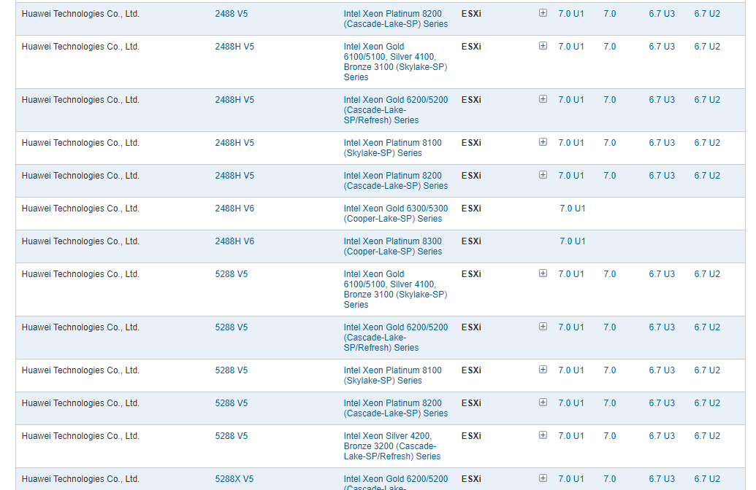
VMware Continues Compatibility Certification & Technical Support
Partners such as VMware, SUSE and Ubuntu will continue to work with Huawei to provide compatibility certification and technical support for FusionServer Pro servers.
On May 23, 2020, VMware announced that Huawei FusionServer Pro 2288H V5 and other servers have passed the latest VMware vSphere 7.0 compatibility certification.
*VMware vSphere, vSAN, and vCenter will continue to provide compatibility certification and technical support for Huawei FusionServer Pro servers.
The latest 2488H V6 (Copper Lake) has been certified
https://www.vmware.com/resources/compatibility/search.php?deviceCategory=server&details=1&partner=242&evcModes=19&page=1&display_interval=50&sortColumn=Partner&sortOrder=Asc

Slide 5
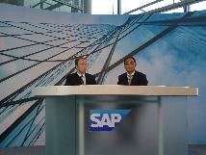
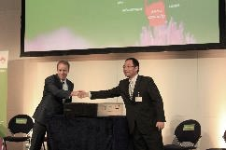
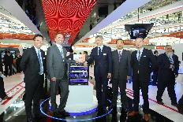
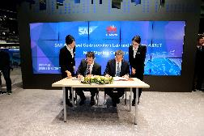
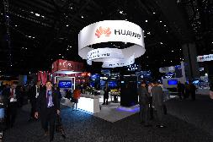
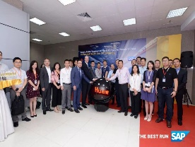
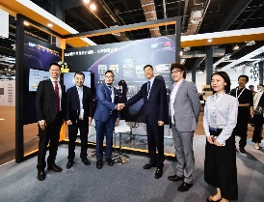
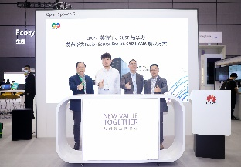

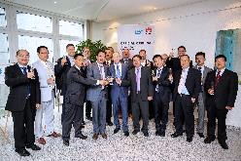
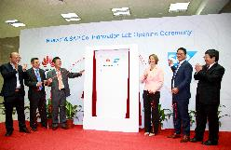
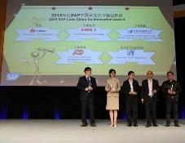
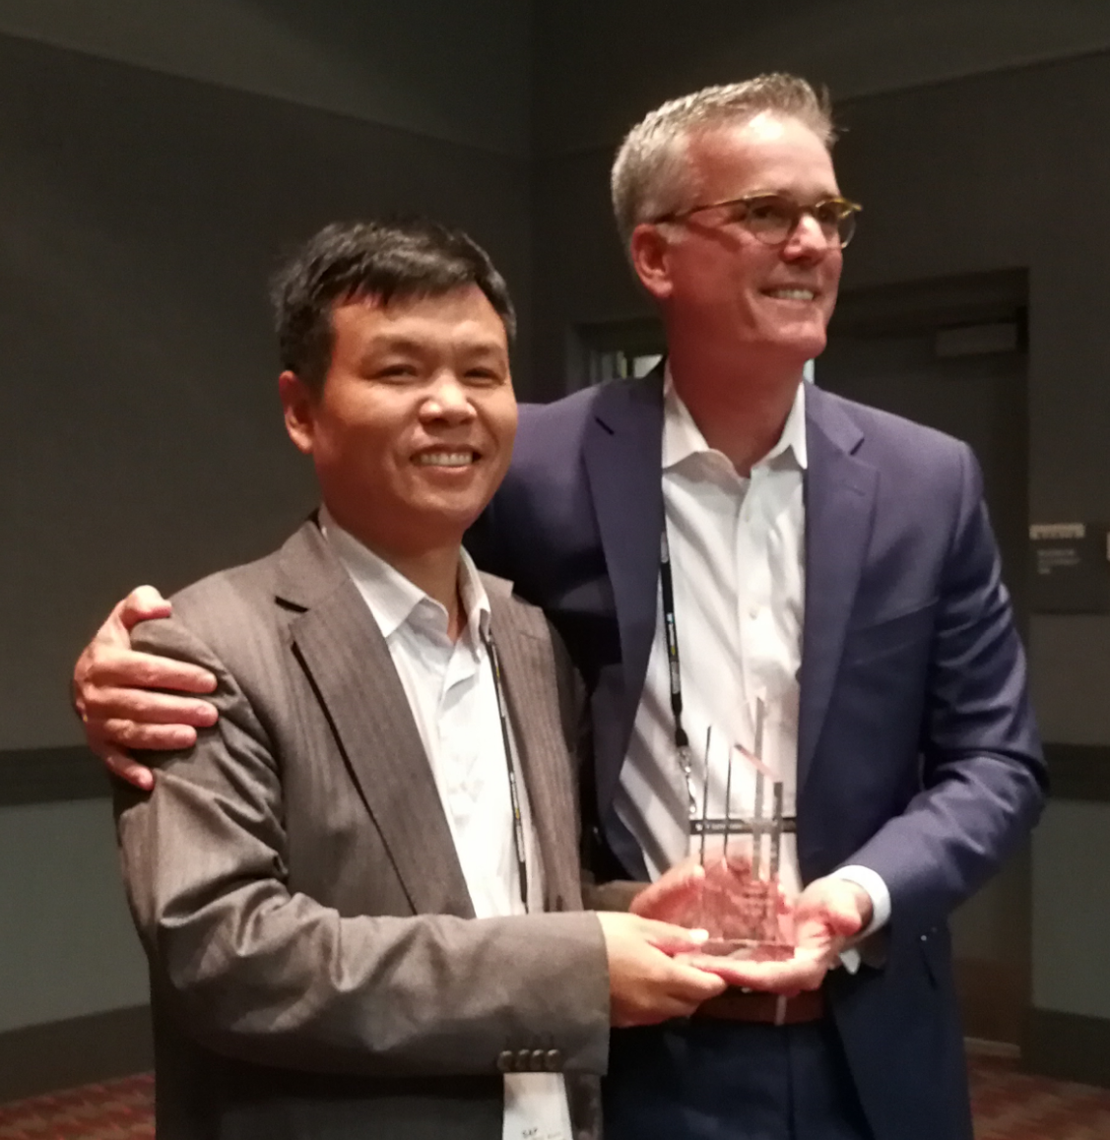
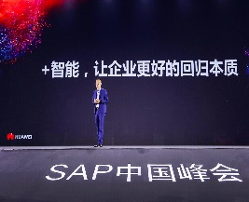

8+ Years Co-Innovation for Build Industry-Leading HANA Solutions
Our Latest SAP HANA solution is available for our latest 2488H V6 server with Optane Memory for big Applications
Huawei became SAP's first global technical partner in China
July 2012
Huawei and SAP jointly launched Tecal RH5885 V2, the first SAP HANA appliance
Feb. 2013
Strategic alliance partnership: Huawei released the certified SAP HANA FusionCube solution at CeBIT 2014
Mar. 2014
Huawei and SAP signed a MoU at CeBIT 2015 to deepen collaboration in Industry 4.0 and the IOT
Mar. 2015
As a top-level sponsor, Huawei attended the SAPPHIRE NOW 2016 global flagship conference held by SAP in Orlando, USA.
May 2016
Huawei & SAP Co-Innovation Center was inaugurated in Zone G of Huawei HQ, Shenzhen.
Aug. 2018
SAP attended HUAWEI CONNECT 2018
as a diamond sponsor and major partner.
Oct. 2018
Huawei and SAP launched the FusionServer Pro V6 SAP HANA solution at HUAWEI CONNECT 2020.
Sep. 2020
2012
2013
HANA platform adoption
2014
2015
2016
SAP Hybris & Ariba contract signed
2017
MaxAttention for Hybris Billing LIVE @ CBG
2018
Hybris Billing Rollout @ CBG & Cloud
2019
2020
Ren Zhengfei, founder of Huawei, met with Jim Snabe, Co-CEO of SAP.
Sep. 2012
Huawei Day was held at Walldorf, Germany, the SAP headquarter.
July 2014
Huawei and SAP announced the official opening of the Huawei & SAP Co-Innovation Center in Shenzhen.
June 2015
SAP conferred the dkom award on Huawei.
Dec. 2015
Huawei won the SAP HANA® Innovation Award at SAPPHIRE NOW held in Orlando.
May 2017
Huawei attended SAP China Summit as a diamond sponsor to explore market opportunities and innovation.
Sep. 2018
Huawei introduced the persistent memory HANA solution for larger HANA memory capacity.
May 2019
SAP Max. Attention | SAP and Huawei Day | Huawei & SAP Co-Innovation Center

Slide 6







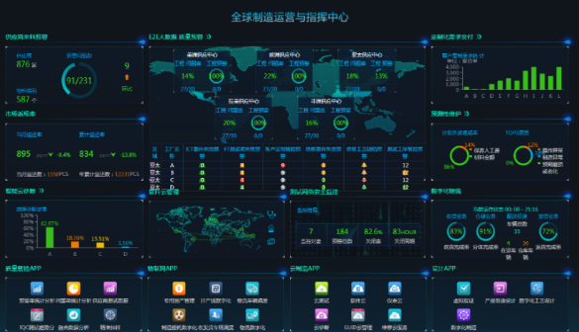




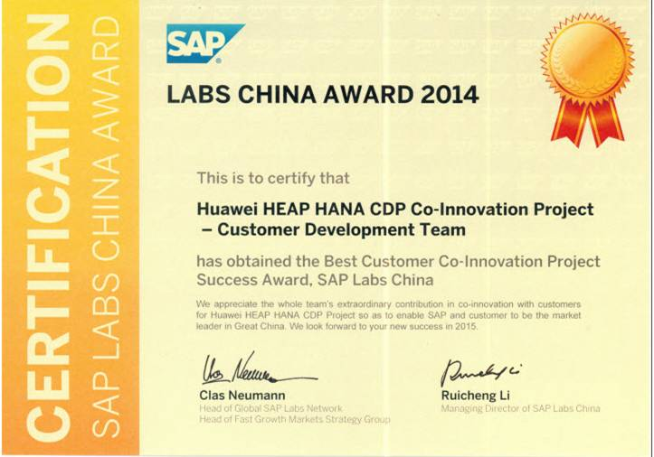



Fruitful Results from Huawei-SAP Close Cooperation
400+ multiple joint innovations
One of SAP HANA's largest customers in China
One of SAP largest market partners
Since 2012, SAP and Huawei have jointly developed more than 400 technological innovations
SAP helps Huawei build the largest SAP HANA-based big data platform in Asia to realize real-time insights in Huawei's finance, supply chain and other fields
Huawei and SAP work together to jointly develop the SAP market
中国南方电网
中国电网
中石化
1,600+
customers
60+
countries
25+
industries

Slide 7
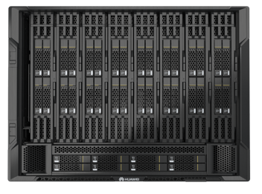
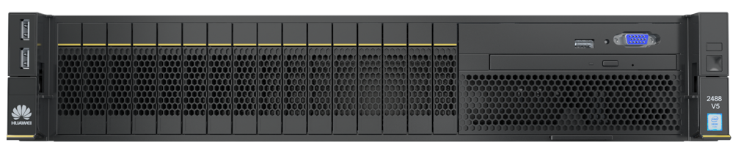
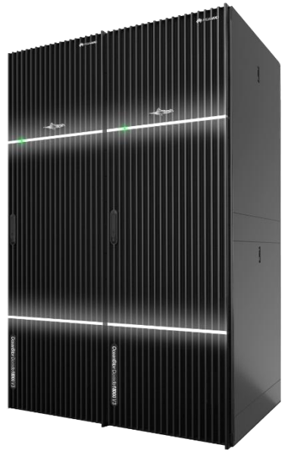
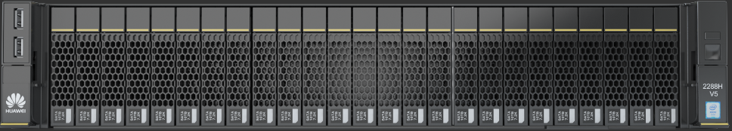
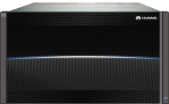
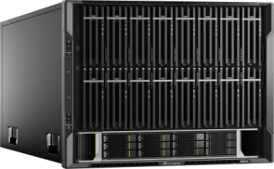
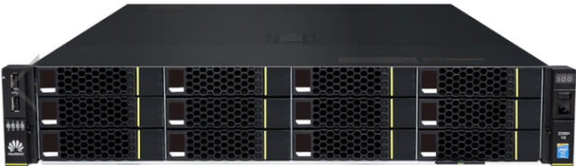
Support All three SAP HANA Models for Flexible Deployment
All three SAP HANA Delivery models are supported for flexible deployment
With the latest 2488H V6 with Optane Memory, up to 18TB memory per node could be supported
Single-node solution
Cluster solution
TDI solution
KunLun 9008 V5 (8S)
FusionServer Pro & KunLun
FusionServer Pro & KunLun
2488H V5/V6 (4S)
2288H V5 (2S)
OceanStor
OceanStor /Dorado
KunLun 9008 V5
2488H V5/V6
2S/1.5 TB
4S/3 TB
6S/4.5 TB
8S/6 TB
2S/1.5 TB
4S/3 TB
2S/3 TB
4S/6 TB
6S/9 TB
8S/12 TB
2S/3 TB
4S/6 TB
Up to 18TB memory/Node with 2488H V6
Notes:
Tailored Datacenter Integration allows HANA customers to leverage existing hardware and infrastructure components for their HANA environment.

Slide 8
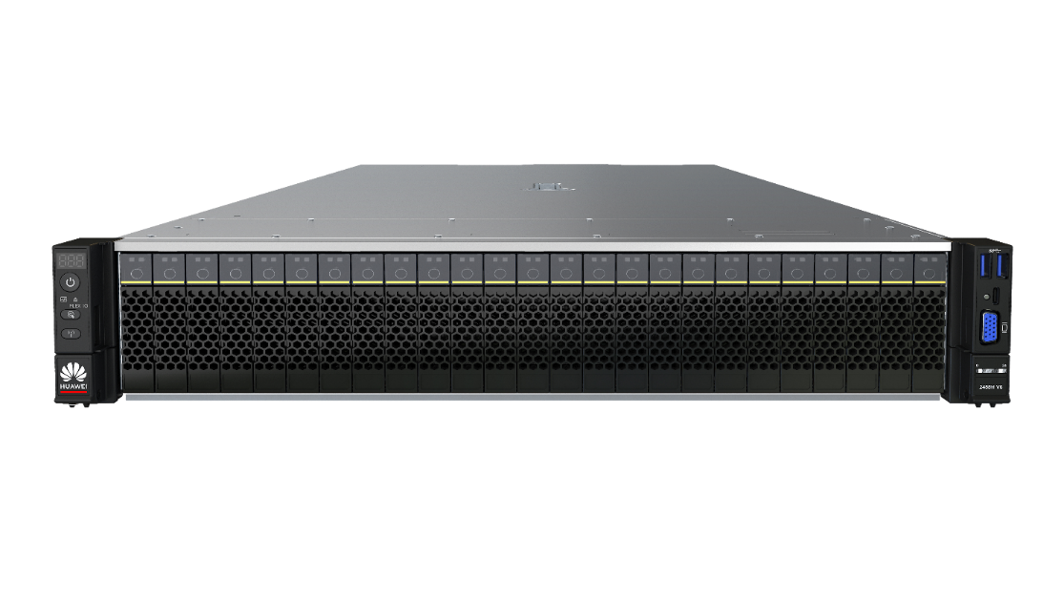

FusionServer Pro V6 SAP HANA Solution is READY
FusionServer Pro 2488H V6 SAP HANA solution
(Single-node solution/Cluster solution/TDI solution)
Stronger computing power, improving SAPS performance by 10%*
4 x 3rd Gen Intel® Xeon® Scalable processors with a TDP of up to 250 W/CPU and 112 cores, improving SAP BWH Benchmark performance by over 10%
Larger memory, reducing CAPEX by 20%
48 DIMM slots, supporting the Intel® OptaneTM persistent memory (PMem) 200 series for up to 18 TB memory capacity
112 cores
18 TB
NVMe
SSD
NVMe SSD, boosting performance by 30%
Supporting HANA appliances with NVMe SSDs and SAS SSDs, NVMe SSDs yield a 30% higher performance over SAS SSDs.
Stronger
computing power
Larger memory
Higher performance
*SAP Application Performance Standard (SAPS) is an authoritative performance indicator in the SAP industry. Generally, SAPS in HANA projects refers to the score in the SD2 benchmark test. In technical terms, 100 SAPS is equivalent to 2,400 SAP transactions per hour, or 6,000 dialog steps (screen changes) and 2,000 postings per hour.

Slide 9
Huawei X86 Servers Leading SAP HANA Performance Benchmark
SAP® BWH Benchmark for 4-socket servers
Query Executions per Hour
Top1
HANA Benchmark
Huawei 2488H V6
Top1
HANA Benchmark
Huawei 2488H V5
SAP BWH Benchmark: 5.2 billion data records, Intel Cooper Lake and Cascade Lake CPU
Source: https://www.sap.com/dmc/exp/2018-benchmark-directory/#/bwh?filters=3782ae74-cbb3-4dc6-ba44-fefe87d9ed4f;6bc6523a-6abc-4c6d-8964-91e7d3b5f5be

Slide 10
Huawei KunLun X86 Servers Leading Reliability for SAP HANA
Unplanned Downtime Due to Inherent system or component flaws per Minute/per Server (2018~2020)
Industry-leading reliability
Source: ITIC 2018~2020 Global Server Hardware Server OS Reliability Survey Results
https://itic-corp.com/blog/2018/08/itic-2018-server-reliability-mid-year-update-ibm-z-ibm-power-lenovo-system-x-hpe-integrity-superdome-huawei-kunlun-deliver-highest-uptime/
https://itic-corp.com/blog/2019/11/ibm-lenovo-hpe-and-huawei-servers-maintain-top-reliability-rankings-cisco-makes-big-gains-ibm-lenovo-hardware-up-to-24x-more-reliable-28x-more-economical-vs-least-reliable-white-box-servers/
https://itic-corp.com/blog/2020/05/itic-2020-reliability-poll-ibm-lenovo-hpe-huawei-mission-critical-servers-deliver-highest-uptime-availiability/
* Inspur has the data of 2020 only

Slide 11





























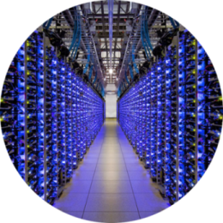

Huawei Servers Powering Global Tier-1 Telcos & Other Industries
Global Tier-1 Telco Customers
211
48
170+
Electric power companies
G500
G100
300+
Financial institutions
120+
Smart City projects
200+
Safe City project
1,000+
Manufacturing companies
300+
Telecom carriers
5+ Million Units
Shipped (2012-2020)

Slide 12




Huawei Server Honor List
400+
New SPEC test records
15%
lower failure rate than industry average*
Trusted & Recognized
Best Supplier**
Gartner MQ Challenger
10000+ Customers
across 25+ industries
* Source: internal statistics of key accounts in the Internet and finance industries
** Awarded by Tencent and Alibaba

Slide 13
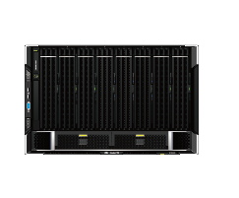
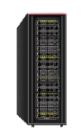
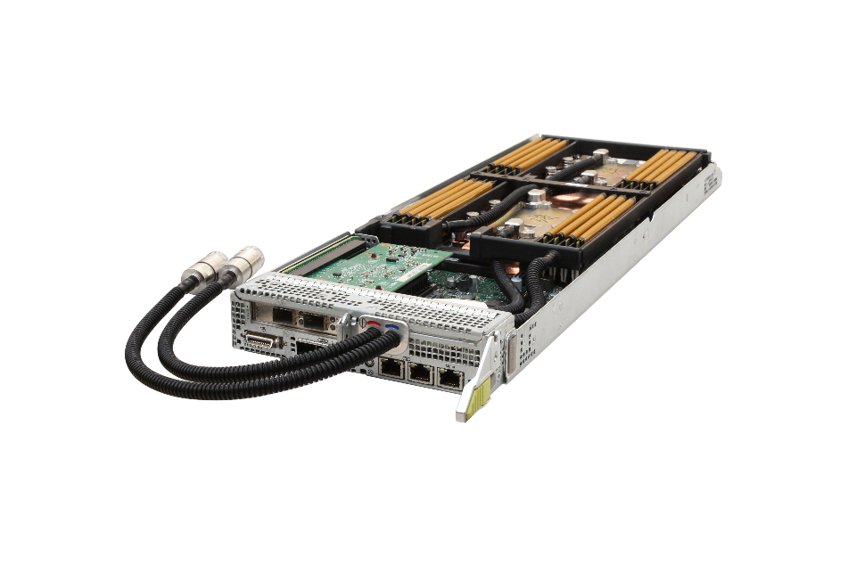
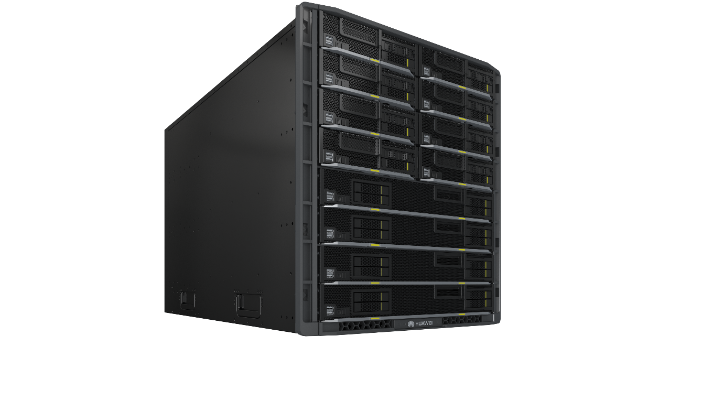
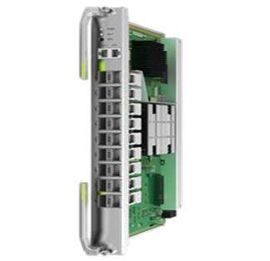
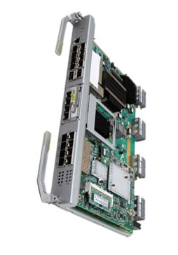
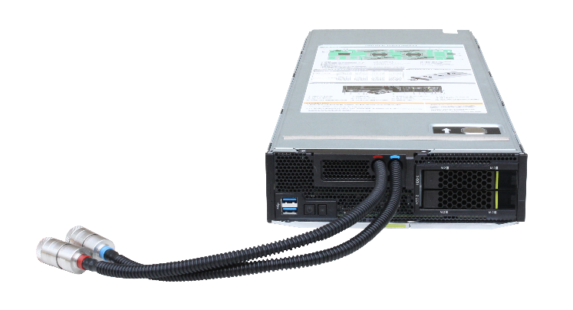
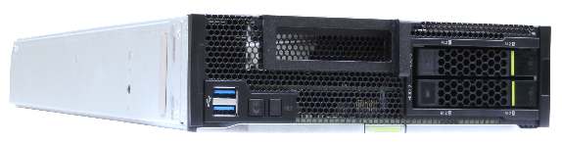
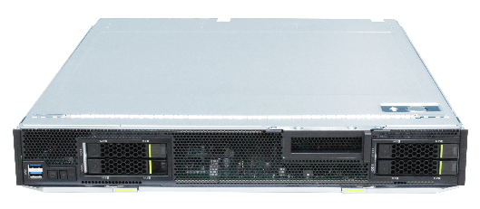
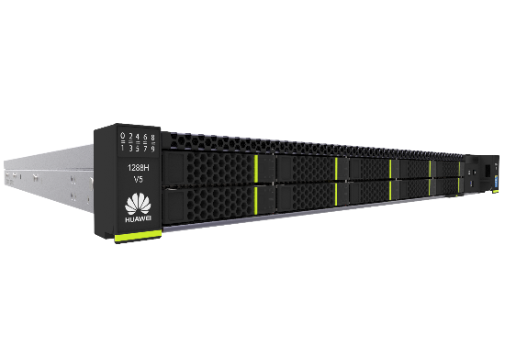
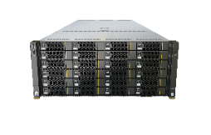
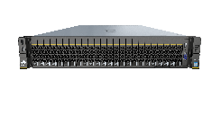
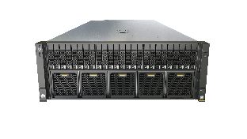
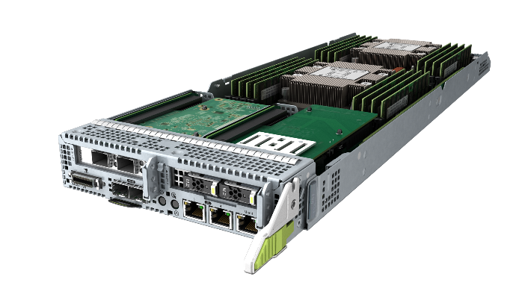

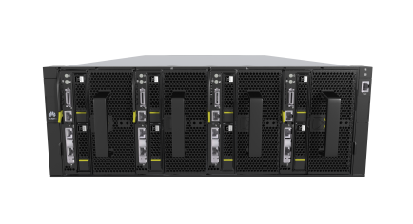
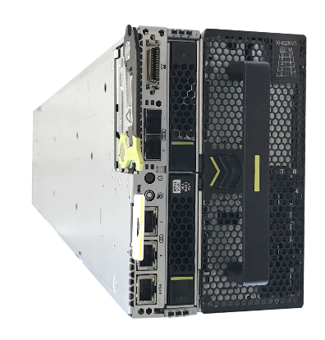










Rich Portfolio to Meet Your Every Intelligent Computing Need
Rich Product Portfolio to meet your needs for different application scenarios:
Balanced, Computing or Storage Intensive, Air or Liquid Cooling, Rack or Blade, etc.
Full series upgraded to the latest Intel Cascade Lake Refresh / Cooper processor, synchronous to Intel CPU Release Schedule
Mission Critical
Full Liquid Cooling Solution for HPC
Converged Blade Servers
E9000
General
Compute-intensive
KunLun 9008 V5
X6000 XH321L V5
E9000 CH121L V5
CH121 V5
CH242 V5
10/25/40/100GE
8/16G FC, FDR/EDR IB
Rack Servers
High-Density Servers
General
Balanced
Storage-intensive
Compute-intensive
Mission critical
2U 4-node
Compute-intensive
4U 4-node
Storage-intensive
1288H V5
2288H V5
2298 V5
5288 V5
2488/H V6
5885H V5
X6000
XH321 V5
XH321L V5
X6800
XH628 V5
Intelligent Acceleration Engine
Intelligent Management Engine
Heterogeneous Servers
NVMe SSD
Intelligent NIC
AI accelerator card
FusionDirector
5 intelligent management features
G5500 full-width server
G5500 half-width server
ES3000 V5
IN200/300
Atlas 300
Nvidia V100 GPU shipping
Ampere GPU coming

Slide 14
Continuous Evolution Roadmap Synchronous to Intel Release Schedule
▼Release
EOM▼
V5: Mainstream sale
V6: Completed R&D & Start to Ship
V7: Started planning
Sales cycle
 |  | 2019 |  |  |  |  | 2020 |  |  |  | 2021 |  |  |  | 2022
 |  | Q1 | Q2 | Q3 |  | Q4 | Q1 | Q2 | Q3 | Q4 | Q1 | Q2 | Q3 | Q4 | Q1 | Q2
2288H V5
2298 V5
2288H V6
2288H V7
1288H V5
1288H V6
1288H V7
5288 V5
5288 V6
5288 V7
2488/H V5
2488H V6
2488H V7
Developing
Planning
Release: 2017.07.31
2021/12/31 EOM ▼
▼ Release: 2019.11.30
2021/12/31 EOM ▼
2RU-2S
▼ Release: 2021.Q1
2023/12/31 EOM ▼
Release: 2017.07.31
2021/12/31 EOM ▼
▼ Release: 2021.Q1
2023/12/31 EOM ▼
1RU-2S
Release: 2018.04.30
2021/12/31 EOM ▼
▼ Release: 2021.Q1
2023/12/31 EOM ▼
4RU-2S
Release: 2017.12.31
2021/12/31 EOM ▼
2RU-4S
▼ Release: 2020.Q3
2022/12/31 EOM ▼
4RU
5885H V5
Release: 2018.03.31
2021/12/31 EOM ▼
X6000 XH321 V5
Release: 2020Q2
2021/12/31 EOM ▼
X6000 XH321 V6
▼ Release: 2021.Q1
2023/12/31 EOM ▼
4RU Multi-Node
X6000 XH321L V5
Release: 2020Q2
2021/12/31 EOM ▼
X6000 XH321L V6
Release: 2021Q2
2023/12/31 EOM ▼
Intel(public)
Cascade Lake
Cooper Lake / Ice Lake
Sapphire Rapids

Slide 15
What Customers Considered When Choosing Huawei Computing
Quality Products
DNA of Telecomm Products, E2E Quality Control
Innovative Product Features
Enabled by Self-Developed ASICs for Management, Perf, Deployment & Diagnosis
Knowledgeable & Experienced Team
Both Hardware & Software, Applications & Operations
Long-Term Commitment & Support
Both spare Parts & Software
Local Support
Quick response & Easy to reach
Competitive Pricing for TCO
Not Only CAPEX, but also OPEX
Partnership & Ecosystem
Strategic Partnership with key players, X86 ecosystem
Rich Product Portfolio
No One Fits All, Rich Models to choose
Consolidation of Suppliers
The same supplier for CT & IT, fewer suppliers to Manage

Slide 16




Quality Product by Design, Process, Sourcing and Testing
Over 30 years of hardware design, development, and manufacturing capabilities coupled with complete product R&D and test processes to maximize server reliability, reduce downtime and data loss, and enhance device maintainability
Component Selection and Process Technique
High Reliability Design
Strict Test and Certification
Enhanced O&M Features
Hard Disk Failure rate 40%
Working Temperature
45°C
Machine Failure rate
15%
Source: Per Internal Testing & O&M Data Collections
Source: Internal Lab Tested for most products
Source: Per a Large Customer Statistics

Slide 17






Efficient Heat Dissipation, Stable Operation at 45°C
The strict electronic component selection, flow-dividing air ducts and independent air channels, and end-to-end heat dissipation design improve heat dissipation efficiency and prolong the service life of electronic components, allowing servers to run stably even when the air conditioners in equipment room are faulty.
≥30%
30%
9%
Reserved margin for component derating design
Counter-rotating fans for higher wind speeds
Flow-dividing air duct and independent air channels for BIO modules improve heat dissipation efficiency





45°C
Stable running at high temperature
For most models
75%
3%
Cellular board design increases porosity rate of the front panel
3D VC heat dissipation with higher efficiency than common VC heat dissipation
Related Videos“Efficient Heat Dissipation”

Slide 18




Triple Anti-Vibration Designs Reduce HDD Failure Rate by 60%
Triple anti-vibration designs for hard drives: Mechanical hard drives have the highest failure rate among server components. The triple anti-vibration designs for hard drives improve stability and reduce the hard drive failure rate.
0.78%
Vibration-damping screws
Vibration source: 8 vibration-damping screws reduce impact of fan vibration on the fan tray
Industry server
drive failure rate
Enhanced rigidity
0.31%*
Vibration path: enhanced chassis rigidity mitigates vibration transfer
Huawei server drive
failure rate
Metallic spring washer & high-damping cushion
Receptor protection: vibration-absorbing components added to drive trays
* Based on the fault statistics of 26,000 hard drives from the data center of a major financial customer.

Slide 19

FusionDirector: 5 Intelligent Management Features Reduce OPEX
Intelligent Asset Management
Server model, configuration, inventorying, and retirement
Inventorying in seconds, improving space utilization by 10%+
Intelligent Deployment Management
Automatic deployment in data center cabinets
10x device rollout efficiency
Intelligent Version Management
Automatic version matching, one-click update
Preparation done in seconds, reducing update steps from 20 to 3
Intelligent Management Engine
Intelligent Fault Management
Fault prewarning, diagnosis, and locating
7–30 days in advance for fault prediction, 93% fault locating accuracy
Intelligent Energy Efficiency Management
Server DEMT, cabinet power capping, and data center linked control
10% server energy saving, 20% higher deployment density

Slide 20
Huawei Server DEMT for 15% higher overall energy Efficiency
The Dynamic Energy Management Technology (DEMT) is a set of technologies that intelligently adjust the power consumption of each component in real time, according to multiple input parameters such as load and ambient temperature.
Intelligent DEMT
Frequency modulation
Hibernation
Proportional-integral-differential (PID) technology
Digital Thermal Sensor (DTS) 2.0
Adjusts the CPU working frequency based on the actual service load.
Hibernates the memory, hard drive, and PSU based on the actual service load.
Quickly adjusts the fan speed based on the CPU temperature changes, reducing the power consumption loss caused by frequent mismatch between processor temperature and fan speed.
Controls the fan speed based on the margin relationship between CPU performance and ambient temperature, reducing the system power consumption.
15%* higher overall energy efficiency
*Data source: Huawei Server Performance Tuning Lab

Slide 21
Huawei FDM Delivers up to 93% Fault Locating Accuracy*
Fault Diagnosis & Management (FDM) is a set of processes and mechanisms for automatic fault information collection (in-band and out-of-band), analysis, diagnosis, and alarm/pre-warning. This greatly improves the fault handling efficiency and shortens the impact of faults on services.
Memory address error parsing
Correctable error storm suppression
Fault locating of the memory link/slot
Out-of-band collection of CATERR fault information
Precise locating of MCERR and IERR
Diagnosis logs
CPU
Memory
Fault diagnosis of multiple links, such as network switching links and SAS links
OS crash information collection
Accurate diagnosis of PCIe card faults
FDM
Others
PCIe
Comparison with Competitors
Comparison Item | Competitor | Huawei FDM
CATERR error collection | Live-network faults cannot be collected onsite. | Fault information is automatically collected comprehensively at a time on site. The information collection does not rely on fault reproduction.
CATERR fault locating | Manual analysis, low success rate | Automatic fault locating: The automatic locating success rate is 80%, the total locating success rate is 93%, and the diagnosis scope is wide.
Other troubleshooting capabilities | Rely on the common fault handling capabilities of the OS; no prewarning capabilities. | Automatic collection, expert system fault alarm, memory correctable error storm parsing and prewarning
Storage medium fault alarm and pre-diagnosis
Storage link diagnosis
HDD/NVMe/SSD/M.2
Storage components
* Source of data: CATERR fault statistics of the Huawei server O&M team

Slide 22


Intelligent Fault Prediction: Predicts Risky Hard Drives 7–30 Days in Advance
Continuous update of massive samples
Continuous inference optimization
FusionDirector
Real-time
Real-time collection of drive SMART information for model analysis on the cloud
Model training
Inference model
Inference result
Prediction model trained on
millions of drives
Drive status data
Accurate
Prediction Accuracy ≥ 90%
Self-Improving
HDD
Prediction ≥ 90%
Reliable
Lower multi-drive simultaneous failure rate
HDD
Replace hard drive
iBMC
HDD
Real-time collection of hard drive information online
Efficient
90% less manpower for fault locating
HDD
Notes:
1. Mechanic HDD is No.1 source for server failure and difficult to predict in the past even if the SMART data is provided by each drive.
2. Now with leveraging the deep learning technologies and the massive HDD failure data collected, FusionDirector could predict risky drives 7-30 days in advance. FusionDirector has a pre-trained & continuous-being-improved HDD fault neural network model, and will query the SMART status data from all provisioned HDDs through the out-band iBMC in real time, and feed to model (i.e. inference) to detect any imminent fault condition. If it does, it will issue an alert for the Admin to take actions such as data migration or order a new drive for replacement. The model accuracy right now is over 90%.
3. The result is: reduction of service disruption substantially

Slide 23







Intelligent Version Management: Automatic Upgrade Of Device Software
Before:
Now:
R&D engineer
Version release
R&D engineer
Version release
Support
Version archiving
Servers
Version archiving
Automatic download
Servers
Manual download
Manual upgrade
API
Automatic upgrade
Version repository SVN
Version repository SVN
Huawei Online Upgrade Platform (HOUP)
Huawei GTS engineer
FusionDirector
Automatic download: Automatically detects the firmware and drivers of servers of different models and manages firmware versions comprehensively
O&M engineers do not need to manually download, upload, or upgrade firmware
Independent out-of-band upgrade, without occupying service bandwidth
Notes:
1. Firmware & Device driver management and upgrade is a time-consuming tedious job even for a small-medium server farm if performed manually, the process is: R&D Release– GTS download manually – GTS upgrade manually
2. Now the new FusionDirector could automatically detect the new versions available, perform version compatibility analysis, and then download & upgrade if applicable, saving a lot of times.

Slide 24











Open & Standard-Based Server Management
Huawei
eService
Industry Equivalent
NBI: XML/REST/SNMP
VM
HP OneView
VM
FusionDirector
VM
OS
OS
eService
client
Cisco UCSM
(Alert SMS or Email)
Lenovo XClarity
APP
APP
Fujitsu ServerView
APP
DELL OpenManager
SBI: SNMP/IPMI/Redfish Restful
iBMC
(each Server)
HP iLO/OA
HP SUM
Server
Server
Server
DELL iDrac
IBM IMM
HMM
(E9000)
Inspur/Lenovo AMI (OEM)
Advanced Server Management based on In-House Developed BMC Controller
(Alert Email)

Slide 25



Accelerating X86 Server Performance
ES3000 series intelligent SSDs
IN200/300 series intelligent NICs
Atlas 300 AI accelerator card
Optimal performance: PCIe Gen4 1.66M Random read IOPS, 7.0GB/s sequential read bandwidth
All-scenarios: low latency, high performance, large capacity
Service-aware: intelligent multi-stream, SR-IOV, atomic write
Converged: 10GE/25GE/40GE/100GE, 8G/16G/32G FC
Accelerated: RoCE
Reliable: industry unique to support firmware upgrade without service interruption
Powerful computing: 64 TOPS of INT8
High-density video parsing: 64-channel HD video real-time analytics
Performance
100% up
Service life
20% longer
CPU offload
15%
Latency
30% less
CPU offload
15%
Performance
64-Ch HD

Slide 26


















Telco Computing Evolution: Cloud, 5G, AI, Intelligent Edge
BSS
BSS
BSS
NFV
BSS
NFV
BSS
NFV
Applications
OSS
OSS
Big Data & Analystics
OSS
Big Data & Analystics
OSS
Big Data & Analystics
IaaS
OSS
Big Data & Analystics
IaaS
↑Agility, Self-Service,
Pay-by-Use, IT as a Business
AI @DataCneter
↑APP Mobility
APP
APP
APP
APP
OS
OS
OS
APP
APP
↑Server Utilization
Cloud Computing
APP
APP
APP
APP
APP
APP
Apps Deployment Model
OS
OS
OS
Container Engine
Container Engine
Hypervisor
Low Latency Network
APP
OS
Hypervisor
Host OS
Host OS
V2X
SmartCity Camera
Autonomous Driving
One App/Server
Many Apps/Server
Many Apps/Server
Many Apps/Server
SmartPole
5G
AI @Edge
Before 200X
Started in 200X
Started in 201X
Started in 201X
Started in ~2020
Hardware
Many CPUs
X86
X86 + GPU
X86 + GPU + AI Accelerators + ARM64

Slide 27

Optimized DIMM Configuration Varies Generation by Generation
Balanced Memory Configuration w/ the same DIMM on every Channel is Crucial to Application Performance
16 or 32 DIMMs
12 or 24 DIMMs
8 or 16 DIMMs
CPU1
6 or 12 DIMMs
CPU1
CPU1
CPU1
CPU2
CPU2
CPU2
CPU2
2019-2020
2021 (V6)
2012-2016
2017
Ice Lake SP(Estimated)
40x Sunny Cove Cores
8-CH DDR4-3200
64-Lane PCIe Gen4
~270W TDP Max
3-Link UPI
AVX/AV2/AVX512
AVX512-VNNI(No BF16)
Max 2x AVX-512
Skylake-SP-V5(2-8s)
28-Core Max
6-CH DDR4-2666
3-Link QPI
48-Lane PCIe Gen3
AVX/AVX2/AVX-512
Max 2x AVX-512
Cascade Lake-SP (2-8S)
Cooper Lake SP(4-8S)
28-Core Max
6-CH DDR4-3200
2/3-Link UPI (6-CPL)
48-Lane PCIe Gen3
AVX/AVX2/AVX512
AVX512-VNNI(CCL)
AVX512-BF16(CPL)
Max 2x AVX-512
2009
Sandy Bridge-V2: 2012
IVY Bridge-V3: 2013
Broadwell-V4: 2015
22-Core Max, 145W
2-Link QPI
4-CH DDR3/4 max 2400
40-Lane PCIe Gen3
AVX (128b-SDB) / AVX2 (IVY)
Nehalem-EP-V1
32b & 64b Compatible
Multiple cores
Multiple sockets
3-CH DDR3 IMC
Integrated PCIe RC
Intel DL Boost: AVX-512-VNNI, AVX-512-BF16, AMX
2008 | 2009 | 2010 | …… | 2015 | 2016 | 2017 | 2018 | 2019 | 2020 | 2021 | 2022 | 2023

Slide 28


Balanced Memory Configuration is Crucial to a lots of Applications
Try to Optimize Memory Configuration w/ Balanced Memory on every Channel if Memory Bandwidth is Critical
The same type and the same number of DIMM(s) on every Memory Channel
Different DIMM Types (R, LR, 1-Rank, 2-Rank, 4-Rank) also have some performance impacts (~10%)
Image source & credit: DellEMC White Paper “Skylake Memory Study”, Author Joseph Stanfield etc., 2018

Slide 29

Understanding & Meeting Your Infrastructure Server Requirements
Description | Entry Server1 | Entry Server2 | Entry Server3 | Mid Server1 | Mid Server2 | Mid Server3 | High Server1 | High Server2 | High Server 3
CPU (cores) | 2x12 | 2x16 | 2x20 | 2x16 | 2x20 | 2x24 | 4x16 | 8x24 | 8x26
RAM(GB) | 4x32GB | 8x32GB | 8x32GB | 16x32GB | 12x32GB | 16x32GB | 32x32GB | 12x128GB | 12x128GB
HDD | 4x4TB SATA 6G | 4x4TB SATA 6G | 6x4TB SATA 6G | 20x4TB SATA 6G | 6x4TB SATA 6G | 6x4TB SATA 6G | 20x4TB SATA 6G | 24x4TB SATA 6G | 24x4TB SATA 6G
SSD | 2x240GB SATA 6G | 2x240GB SATA 6G | 2x240GB SATA 6G | 2x960GB SATA 6G | 2x960GB SATA 6G | 2x960GB SATA 6G | 2x3.84TB SATA 6G | 2x3.84TB SATA 6G | 2x3.84TB SATA 6G
Server Config
NIC Config
Huawei Server | 1288 V5 | 1288 V5 | 1288 V5 | 2288 V5 | 2288 V5 | 2288 V5 | 2488 V5/V6 | 9008 V5 | 9008 V5

Slide 30
Notes:
Thanks!

